Slide 1
Site Sensing and Data Mining for Construction Performance Improvement
Carlos H. Caldas, Ph.D., PE
Department of Civil, Architectural and Environmental Engineering
The University of Texas at Austin

Slide 2
Agenda
Real-Time Spatial Information Acquisition and Use
Image-Based Safety Assessment
Materials Tracking
Video Analysis for Productivity Measurement
Semi-Automated Activity Analysis

Slide 3
Real-Time Spatial Information Acquisition and Use
Acknowledgement: My Former Ph.D. Student
Dr. Jochen Teizer
Former Associate Professor
Georgia Institute of Technology, USA

Slide 4
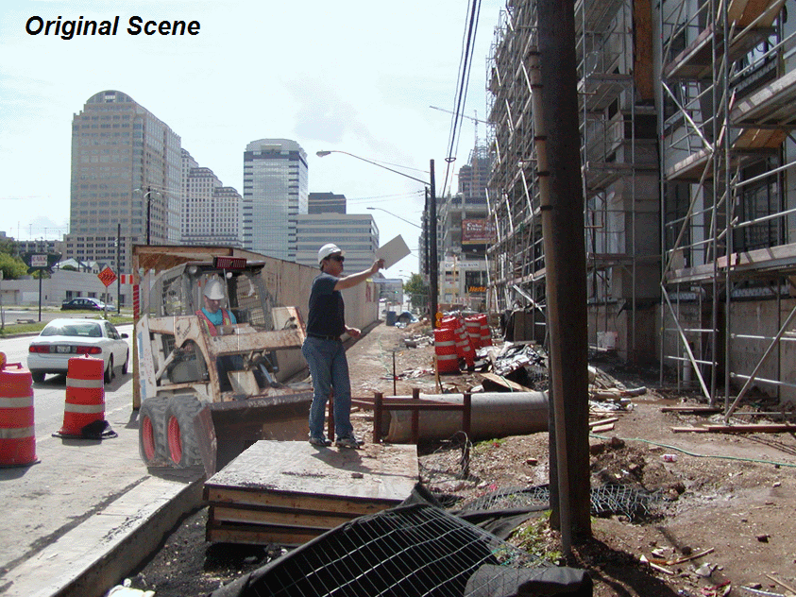
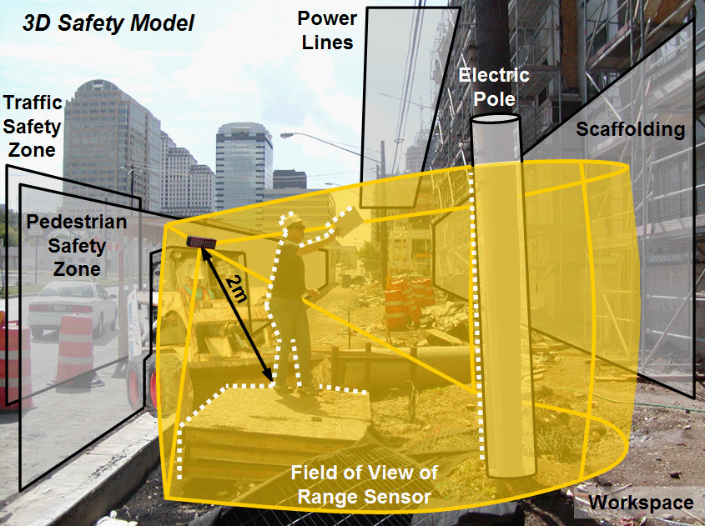
Real-Time Spatial Information Acquisition and Use for Infrastructure Construction and Maintenance
This project developed methods of acquiring, integrating, modeling, and analyzing project site spatial data, including dynamic site information (motion of personnel and equipment), that allow scalability and robustness for real-time field deployment and with sufficient accuracy for applications such as real-time safety monitoring, productivity studies, and advanced equipment control.
(NSF Award Number: CMS 0409326)

Slide 5
Motivation
Need for safety in construction/infrastructure:
1224 fatalities in 2005
Many accidents occur while operating heavy equipment
Analysis of Fatalities on Construction Sites (OSHA, 2002)

Slide 6
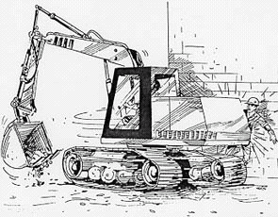
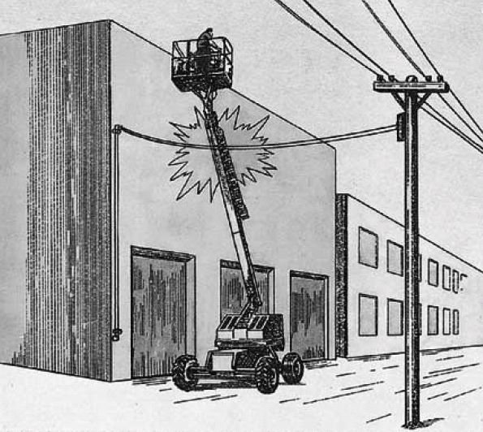
Motivation
Development of active safety features using 3D data
reduce the likelihood of accidents such as
Collision of heavy equipment with people (OSHA, 2003)
Collision of heavy equipment with power line (OSHA, 2003)
“Create virtual safety nets for job sites”

Slide 7
Research Objectives
Detect and track static and moving objects from a static or moving sensor
Develop robust real-time processing algorithms
Verify/validate via experiments (indoor and outdoor)
Objects’ position
Objects’ dimensions
Objects’ direction of movement
Objects’ velocity

Slide 8



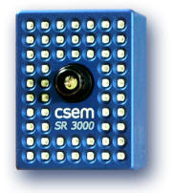
Real-Time 3D Imaging
Detecting and tracking moving objects in real-time
Static Box Human walking Bicyclist
3D Range Sensor

Slide 9
Overview of the Modeling Approach

Slide 10
Results
At occupancy grid size of 0.1m

Slide 11
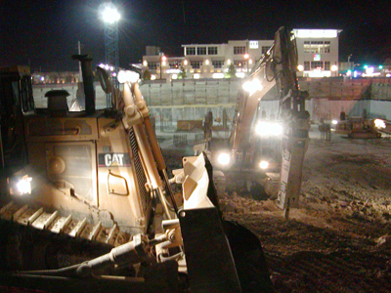
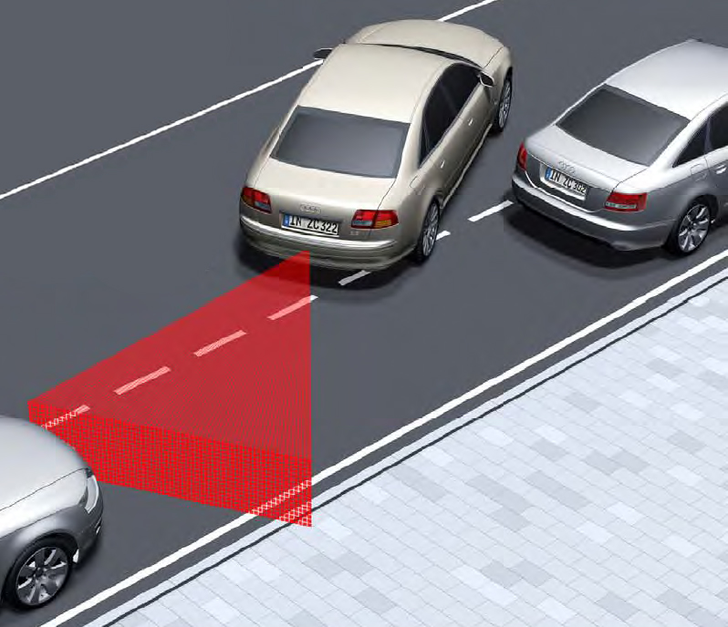
Applications
Source: Teizer et al., 2005, Leica HDS Inc., Audi AG
Work Zone Safety
Integrated Vehicle-Based
Safety Systems (IVBSS)
OSHA, 2002
Bernold et al., 2003
Kim et al., 2003
US DOT, 2004
Audi and Continental (TEMIC), 2005
DaimlerChrysler (DSRC), 2005

Slide 12
Image-Based Safety Assessment
Acknowledgement: My Former Ph.D. Student
Dr. Seokho Chi
Assistant Professor
Seoul National University, Korea

Slide 13
Motivation
Safety first!
U. S. Occupational Safety and Health Administration emphasized “Employers are responsible for preventing workers with a safe working environment.” (Wilson and Koehn, 2000)
Advances in technologies for safety improvement
Construction resource detection and tracking
Workspace 3D sensing and modeling
…
➔ Support automated and informative safety decision making

Slide 14
Research Objectives
Design an error impact analysis testbed for image-based safety assessment
To model data collection and data processing errors
To analyze the impact of the errors for safety assessment
Steps
Identify data needs for spatial safety assessment
Analyze image-based data collection devices and algorithms
Develop safety rules based on spatial data
Conduct error impact analysis using these safety rules

Slide 15
Data Needs for Safety Assessment
SPATIAL SAFETY RISK FACTORS
(1) Excessive operation speed
(2) Dangerous access to unstable piles, unstable grounds, berms, and road edges
(3) Inadequate clearance and limited visibility
SOURCES
Fatality investigation reports
Operation safety handbooks
Industrial experts’ opinions
Safety Regulations & Best Practices
EXAMPLES
“Operators should follow the speed limit”
“Hazard areas should be marked with a warning against entry”
“Stopping distances should be maintained between heavy machinery”
SPATIAL DATA NEEDS
(1) Moving speed
(2) Proximity to dangerous areas
(3) Stopping distance and
Proximity between objects
(NIOSH, 1998; NIOSH, 2001; MSHA, 1999; MSHA, 2001)

Slide 16
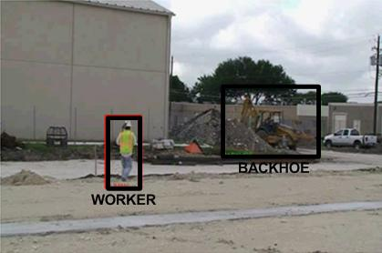
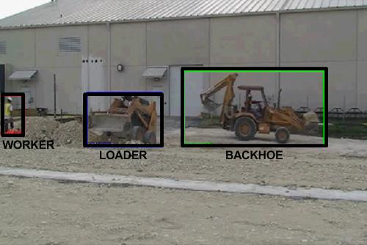
Object Identification
Object identification using stereo vision camera

Slide 17
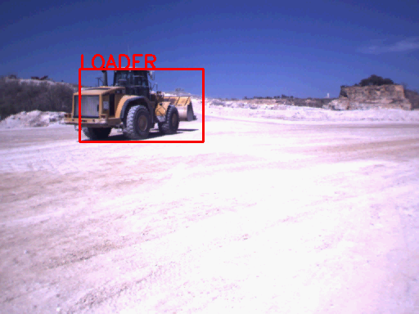
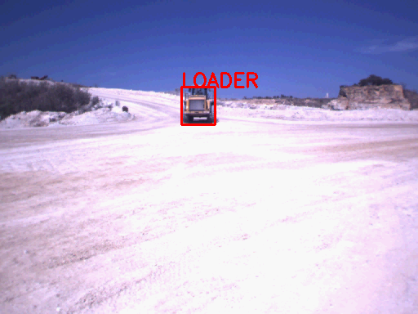
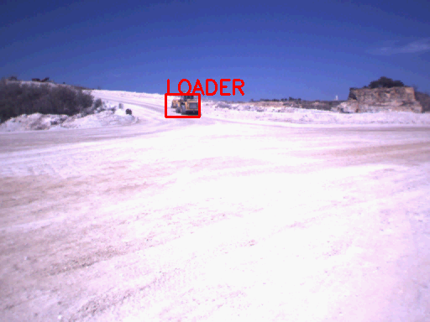
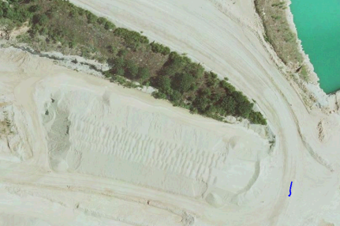

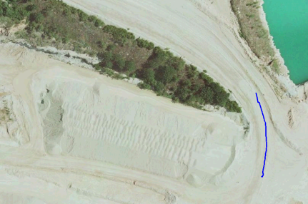
Object Tracking
Object tracking using stereo vision camera

Slide 18
Safety Rules Determination
SPATIAL DATA NEEDS
(1) Moving speed
(2) Proximity to dangerous areas
(3) Stopping distance and
Proximity between objects
VIOLATION TYPES TO BE MONITORED
(1) Speed limit violation
(2 ) Access violation to dangerous areas
(3) Close proximity violation

Slide 19
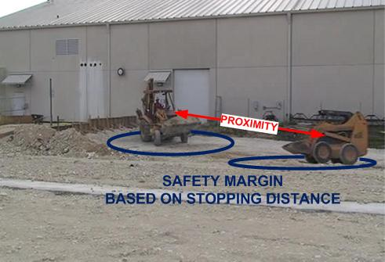
Safety Rules Determination
Safety rule: Close proximity violations
“A close proximity violation occurs when the proximity between heavy machinery is smaller than their stopping distances.” (Oloufa et al., 2003; Riaz et al., 2006)

Slide 20
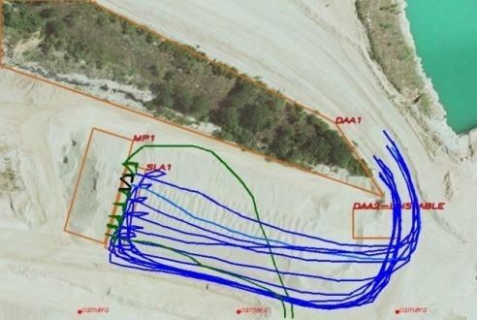
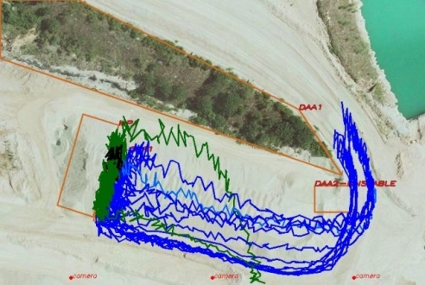
Testbed: Internal Processing
Error Impact Analysis
Original Trajectory
Revised Trajectory
Random
Tracking Error Generator
(0% ~ 30%)
Original Classification
1st image: Loader
2nd image: Loader
3th image: Loader
4th image: Loader
Revised Classification
1st image: Loader
2nd image: Truck
3th image: Loader
4th image: Loader
Random Identification Error Generator
(0% ~ 30%)

Slide 21
Testbed: Internal Processing
Error Impact Analysis
Safety rule for violation detection
Different time interval (0~5sec) for violation detection
Revised Trajectory & Classification Information
Safety Rule
Safety Decision
Violate or not?
Detected Violation
at 7 second: speed limit
at 7.5 second: none
at 8 second: speed limit
at 8.5 second: speed limit
at 9 second: speed limit
frame-by-frame
# of violation detected: 4
1-second interval
# of violation detected: 1

Slide 22
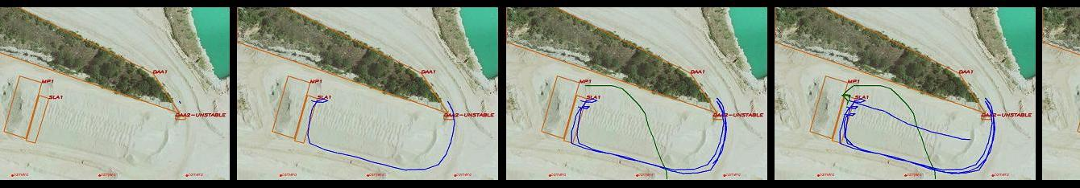

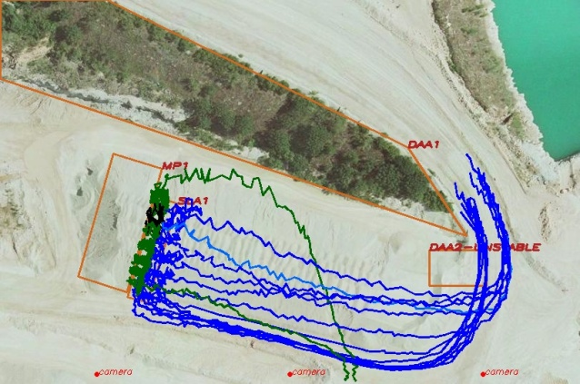

Testbed: Output Data
Error Impact Analysis
Movie file showing simulated scenario
Trajectory with different tracking error rates
0%
4%
10%

Slide 23
Materials Tracking
Acknowledgement: My Former Ph.D. Student
Dr. David Grau
Assistant Professor
Arizona State University, USA

Slide 24
Motivation
Manual collection of site data is error-prone, inefficient, and expensive (Sacks 2003; Ergen 2007)
Workers spend large amounts of their time either searching or waiting for components (Rojas 2003; Caldas 2006)
The inability to locate needed items negatively affects installation productivity (CII 1986; Thomas 1989; CII 1999)
Construction activities require constant visibility for proper control (Stone 1995; Hwang 2004; Fiatech 2008)
Previous studies determined that information technologies have a great potential to improve site tracking processes (Vorster and Lucko 2002)

Slide 25
Research Objectives
To develop a model for the automated identification and localization of construction components on large industrial projects, and
To assess/validate the impact of the automated identification and localization approach on a construction job site

Slide 26
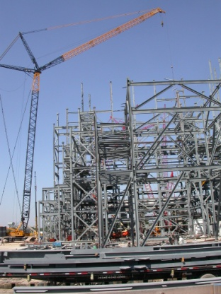
Research Scope
The focus of this study is on the automated identification and location of construction components on industrial sites
Job Site
Supply Chain Process

Slide 27
Research Scope
Large industrial projects:
Extensive lay down yards far from installation areas
Thousands of engineered components
Notes:
Change picture

Slide 28
Localization Approach
A worker equipped with GPS and RFID receivers identifies tagged components around the his/her own GPS position
These receivers could also be installed on
construction equipment (e.g. cranes)

Slide 29
Localization Approach
Uncertainty of tags location is reduced from (a) the RFID read area to (b) much smaller areas by localization algorithms
(a) Original uncertainty area ≈30,000m²
(b) Reduced uncertainty area ≈ 40m²

Slide 30
Localization Model
Model Schema

Slide 31
Data Collection Module
Senses, collects, and stores the worker’s GPS positions and the unique RFID identification codes
Sensor synchronization
Data fusion

Slide 32
Location Estimation Module
Centroid Algorithms
For a given tag, its estimated location is the centroid of the K GPS positions where the tag was identified
Positions weighted according to the RFID signal strength
Localization error
Signal Strength
0 db - Max. signal strength
-90db - Min. signal strength

Slide 33
Location Estimation Module
Proximity Algorithms
It assumes an square RFID signal pattern of side ρ
For a given tag, the four GPS positions situated at axis extremes (maximum and minimum X and Y) determine the smallest uncertainty area
Localization error

Slide 34
Navigation Module
Mapping/navigation functions
Integration of GIS (Geographic Information Systems) and real-time differentially corrected GPS
Alternatively, printed maps can enable navigation

Slide 35
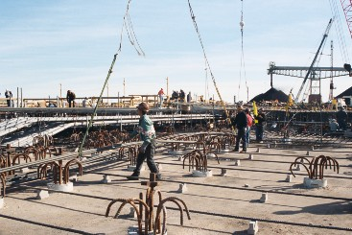
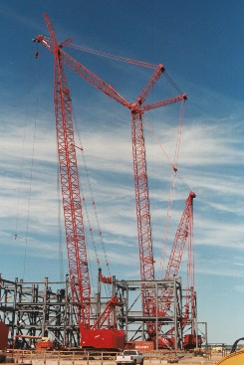

Field Trial
The project:
CII RT240 “Leveraging Technology to Improve Construction Productivity”
University of Waterloo; University of Kentucky; University of Texas
Coal power plant project, Rockdale, TX
$900 million
650 MWatts
Open job
Two almost identical boiler support steel structures

Slide 36
Field Trial
Methodology:
Comparision of labor and productivity records between similar boiler installation sequences of tagged and non-tagged steel components

Slide 37
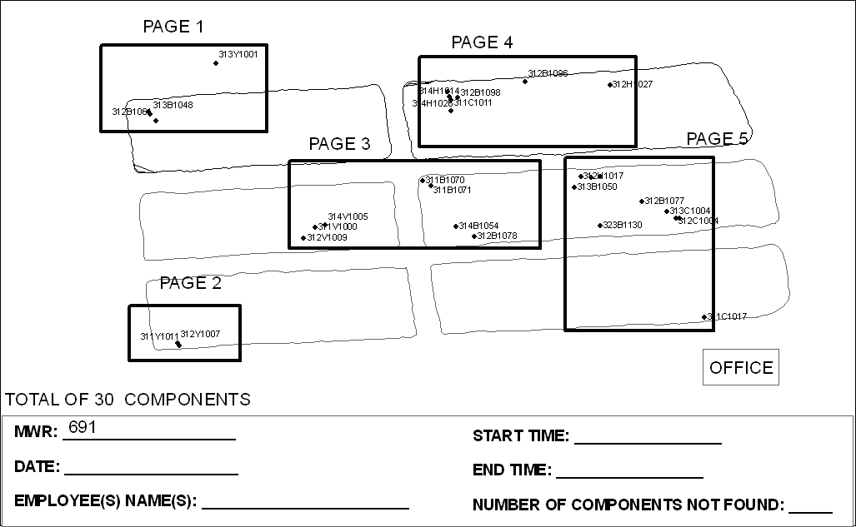
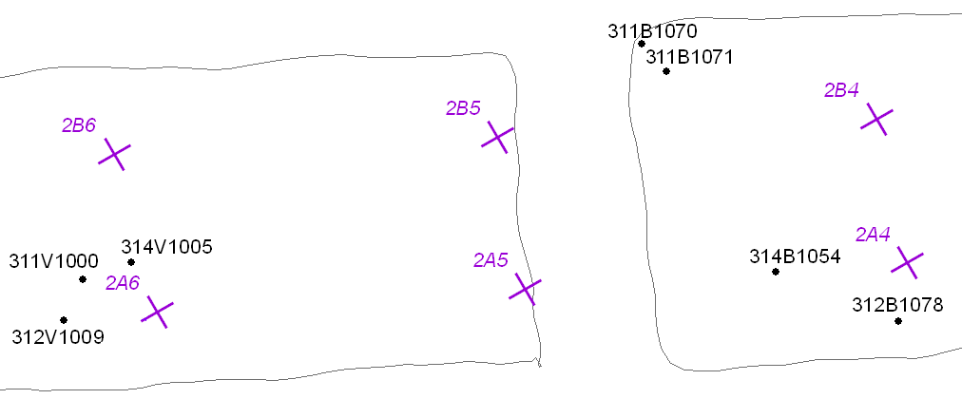
Lay Down Yard Navigation
MWR Map
Detail Page 3

Slide 38
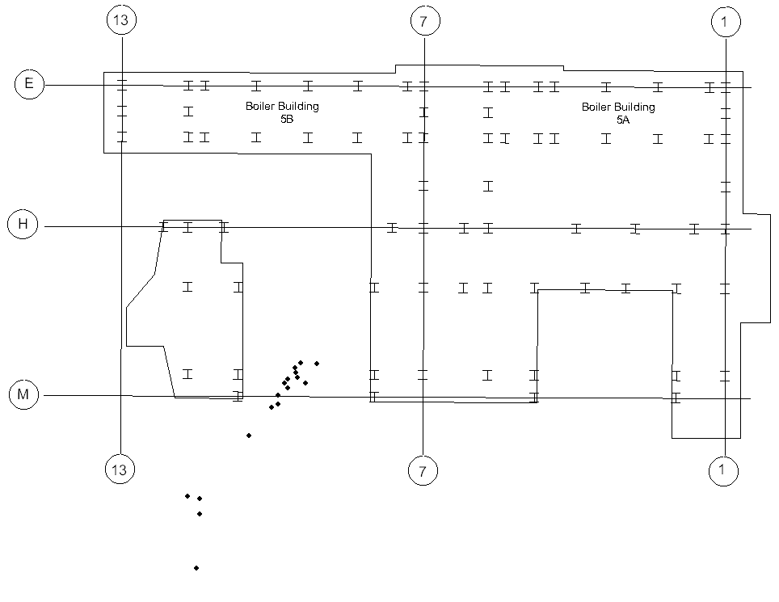
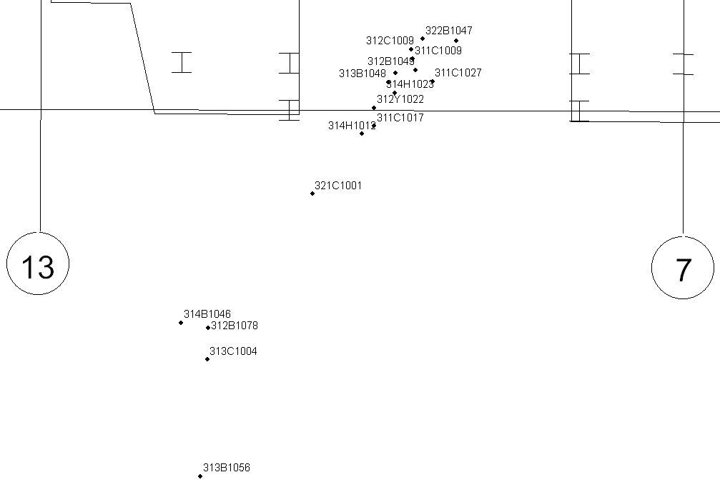
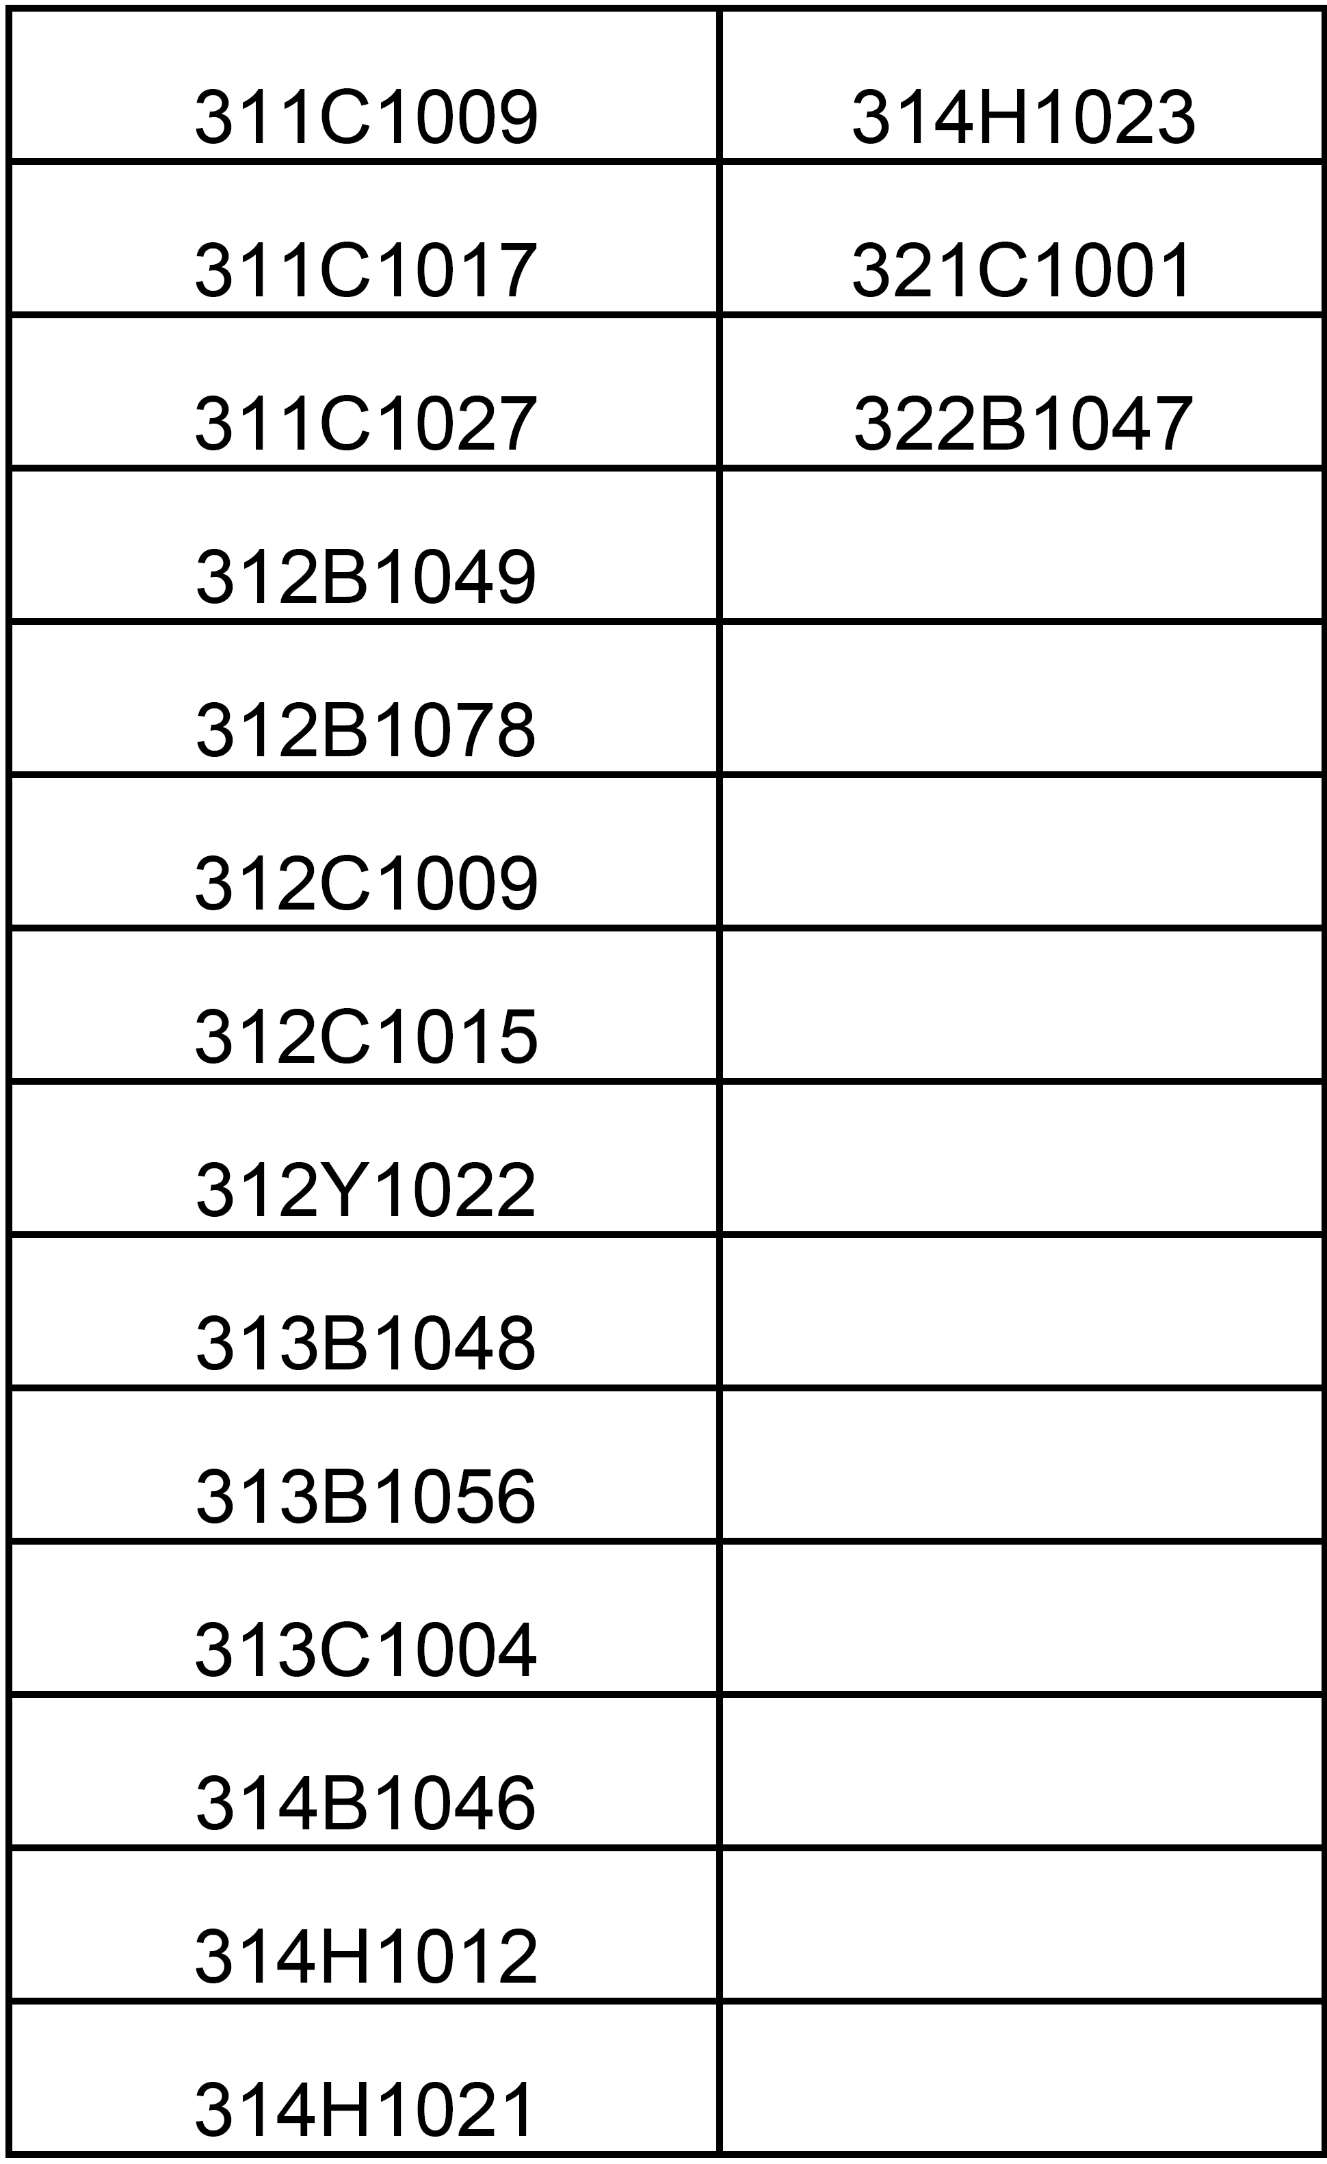
Staging Area Navigation
Staging Map
Detail Page 1
List of mapped components

Slide 39
Results - Craft Work Hours
Current process:
494 sec (8.2 min)
per component
Automated process:
195 sec (3.2 min)
per component
2.5 productivity ratio

Slide 40
Lost components
10% of untagged components (35/366) not immediately found
0.5% of tagged components (2/366) not immediately found
Extra time required to find these “lost” components

Slide 41
Predictability
Searching and flagging times:
Untagged Components
Median: 301 sec (5.1 min)
Maximum: 1,150 sec (9.2 min)
Minimum: 131 sec (2.2 min)
Tagged Components
Median: 124 sec (2.1 min)
Maximum: 450 sec (7.5 min)
Minimum: 50 sec (0.8 min)

Slide 42
Video Interpretation For Productivity Measurement
Acknowledgement: My Former Ph.D. Student
Dr. Jie Gong
Assistant Professor
Rutgers University, USA

Slide 43
Motivation
Low construction productivity
49.6% of craft hour hours devoted to non-value added activities (Horman and Kenley 2005)
(Gong, Borcherding, and Caldas, 2011)

Slide 44
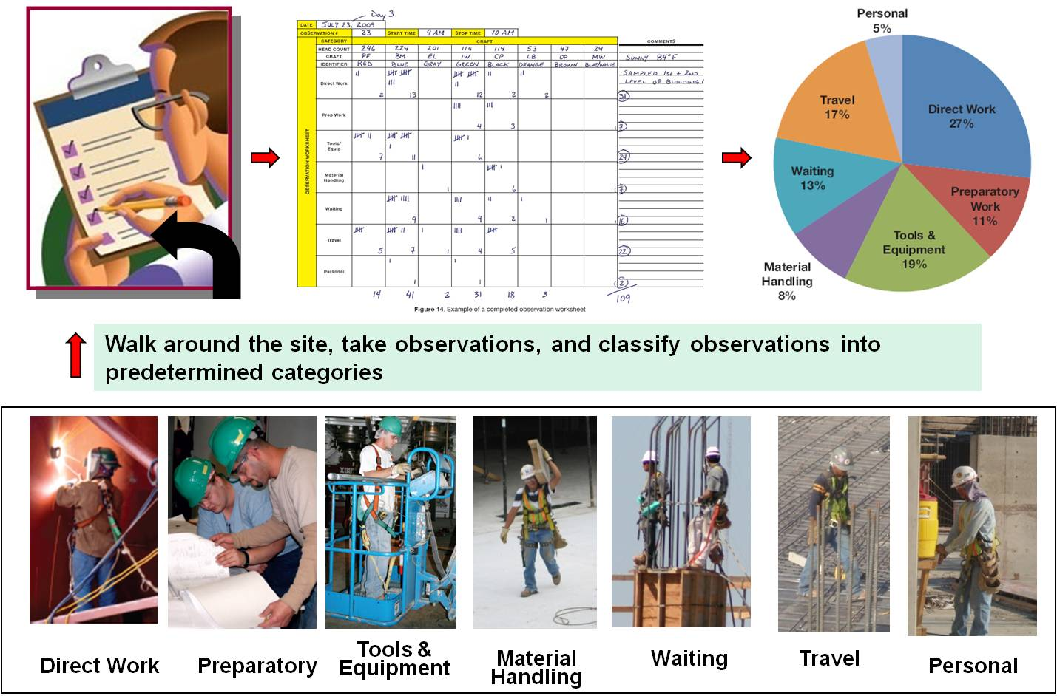
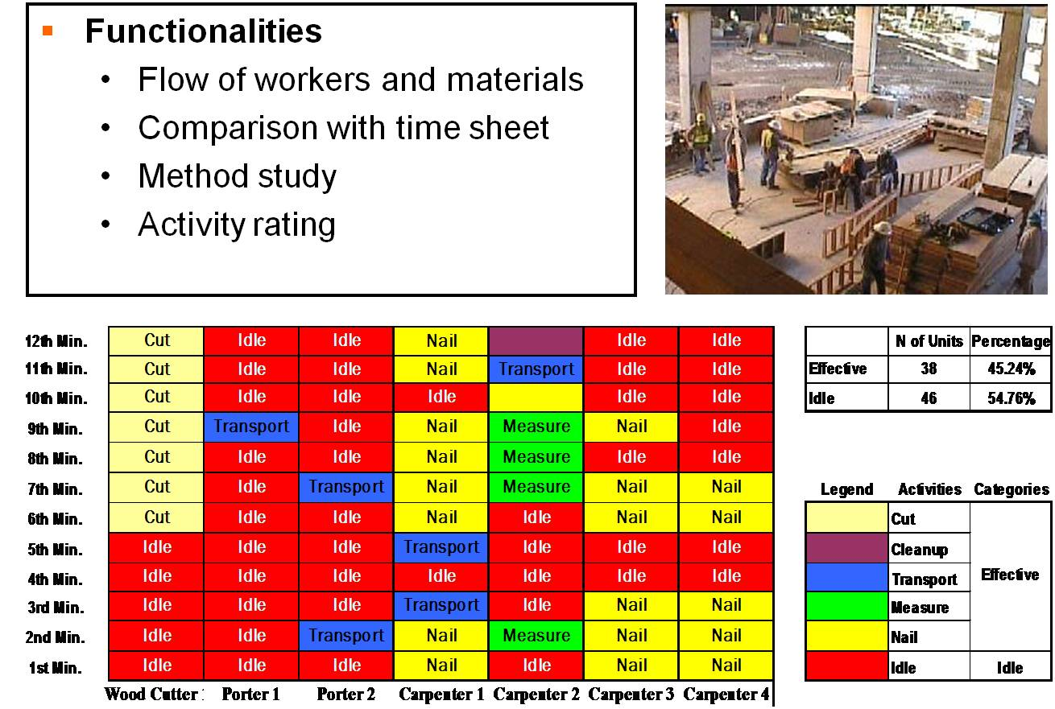
Motivation
Issues with current productivity measurement methods:
Extensive manual work (Navon 2007; Hildreth et al. 2005)
Error-prone and expensive (Navon and Sacks 2007)

Slide 45
Research Objectives
Formalize a computational representation of the process of video-based productivity analysis.
Design mechanisms of leveraging prior construction knowledge to assist productivity-oriented video reasoning.
Characterize and integrate a set of computing methods to support the recognition and tracking of construction resources.

Slide 46
Proposed Video Interpretation Methodology

Slide 47
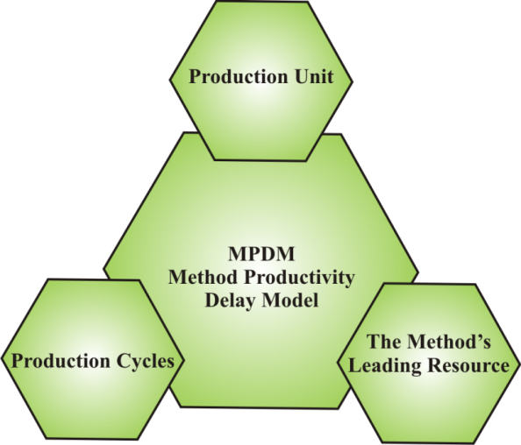
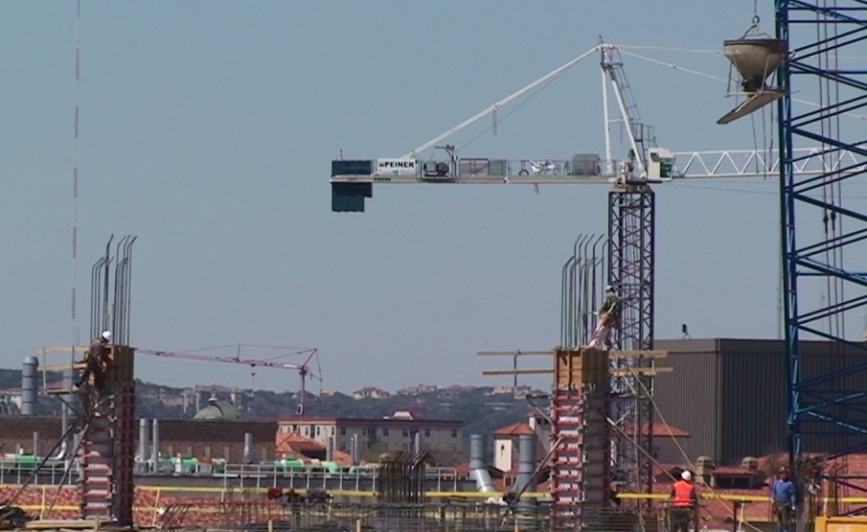
Visual Recognition and Tracking
Leverage domain knowledge to determine which object to recognize and track
Method Productivity Delay Model
Sample Case
An amount of work that can easily be visually measured
Column Pour
Production Unit = Concrete Bucket
The Method’s Leading Resource = Concrete Bucket
The time between consecutive occurrences of the production unit
The most basic or fundamental resource
Adrian (1974)

Slide 48
Model-Based Reasoning – Formal Steps
State Classification
Definition: Object status in predetermined categories
Example: <<waiting>>, <<working>>
Event Detection
Definition: Change of states
Example: <<waiting → working>>
Scenario Recognition
Definition: A situation inferred according to a predetermined rule sets
Example: <<process violation>>
Time Utilization
Workflow
Abnormal Scenario
Reasoning Steps
What to measure?

Slide 49
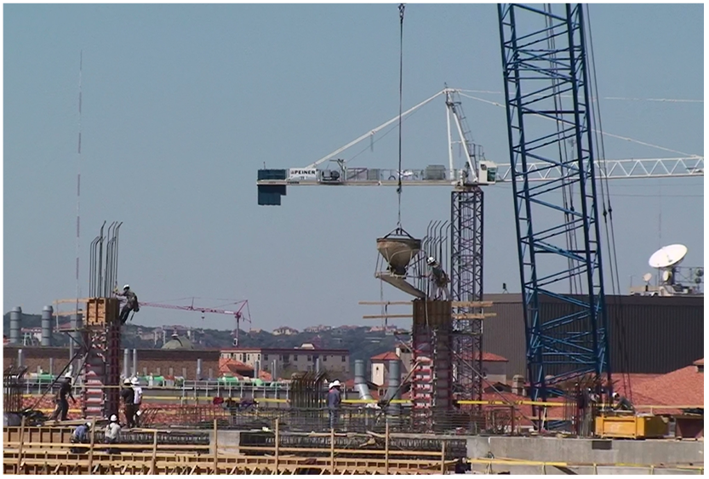
Model-Based Reasoning – Representing Prior Knowledge
Bucket Ready Zone
Semantic Context
Task elements
Spatial Context
Spatial layout
Work zones
Temporal Context
Activity sequences
Time constrains
Bucket Pour Zone
Process Model
or
Process Chart

Slide 50
Video Content Organization and Retrieval

Slide 51
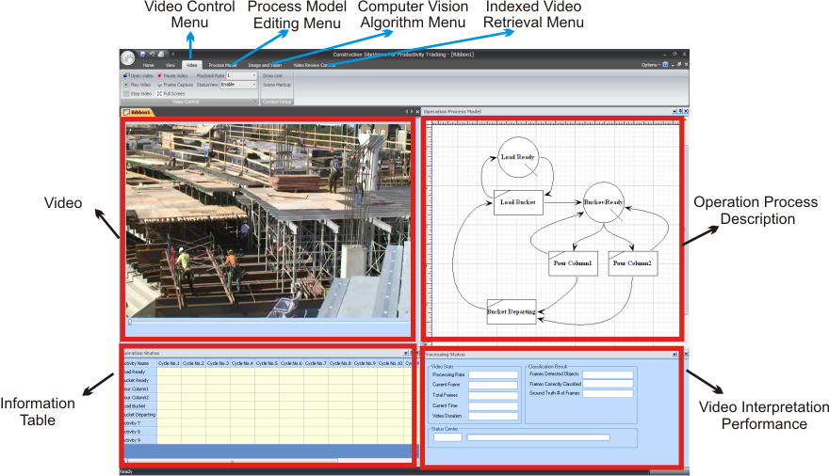
Implementation of Video Interpretation Methodology
VC++ Microsoft Foundation Class (MFC)
Intel Open Source Computer Vision Library
DirectShow

Slide 52
Validation Cases
Repetitive Operations
Column Pour Operation
Slab Pour Operation
Earthmoving Operation
Non-Repetitive Operations
Scaffold Installation
Hoisting Operation

Slide 53
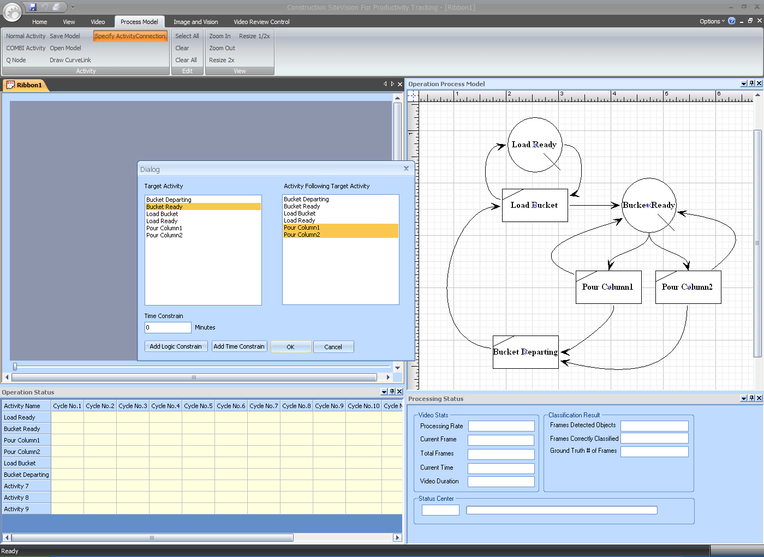
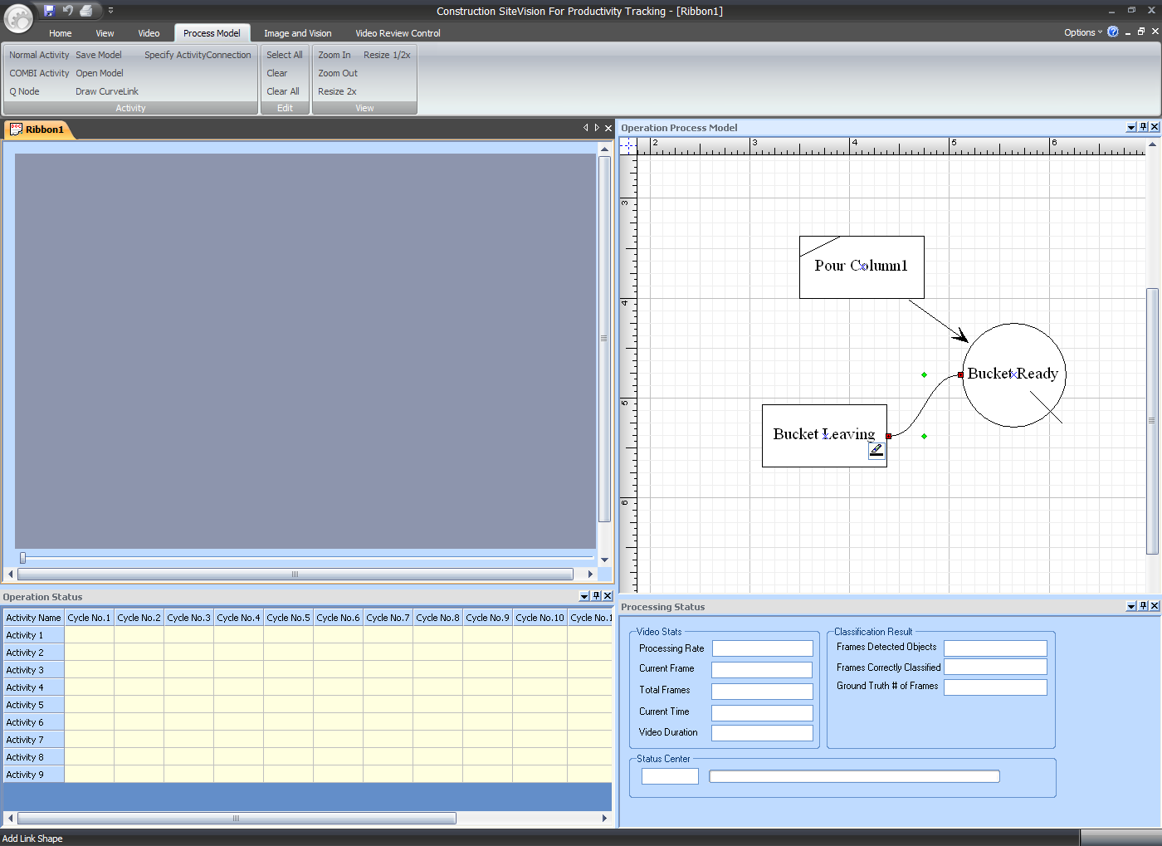
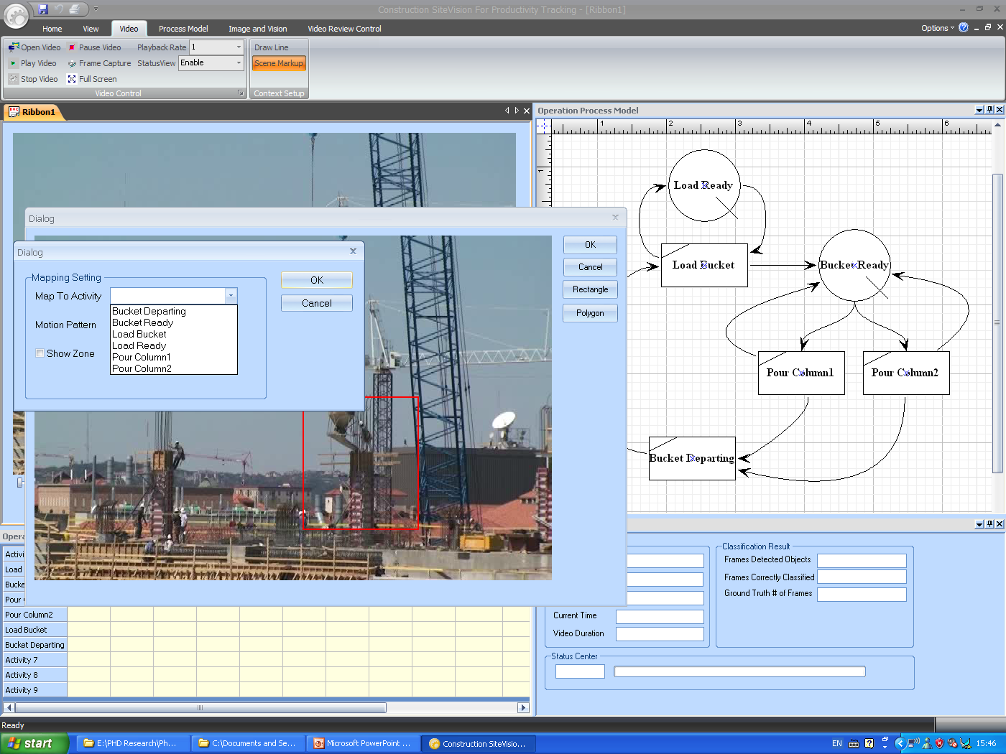
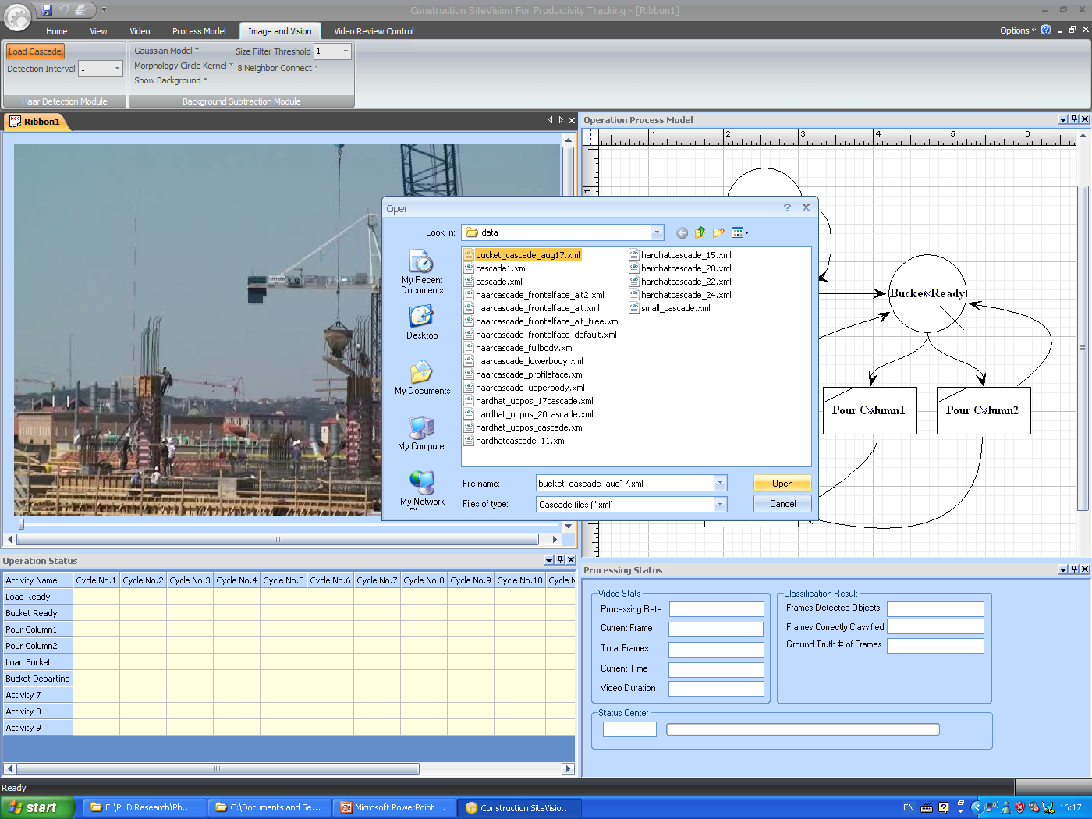
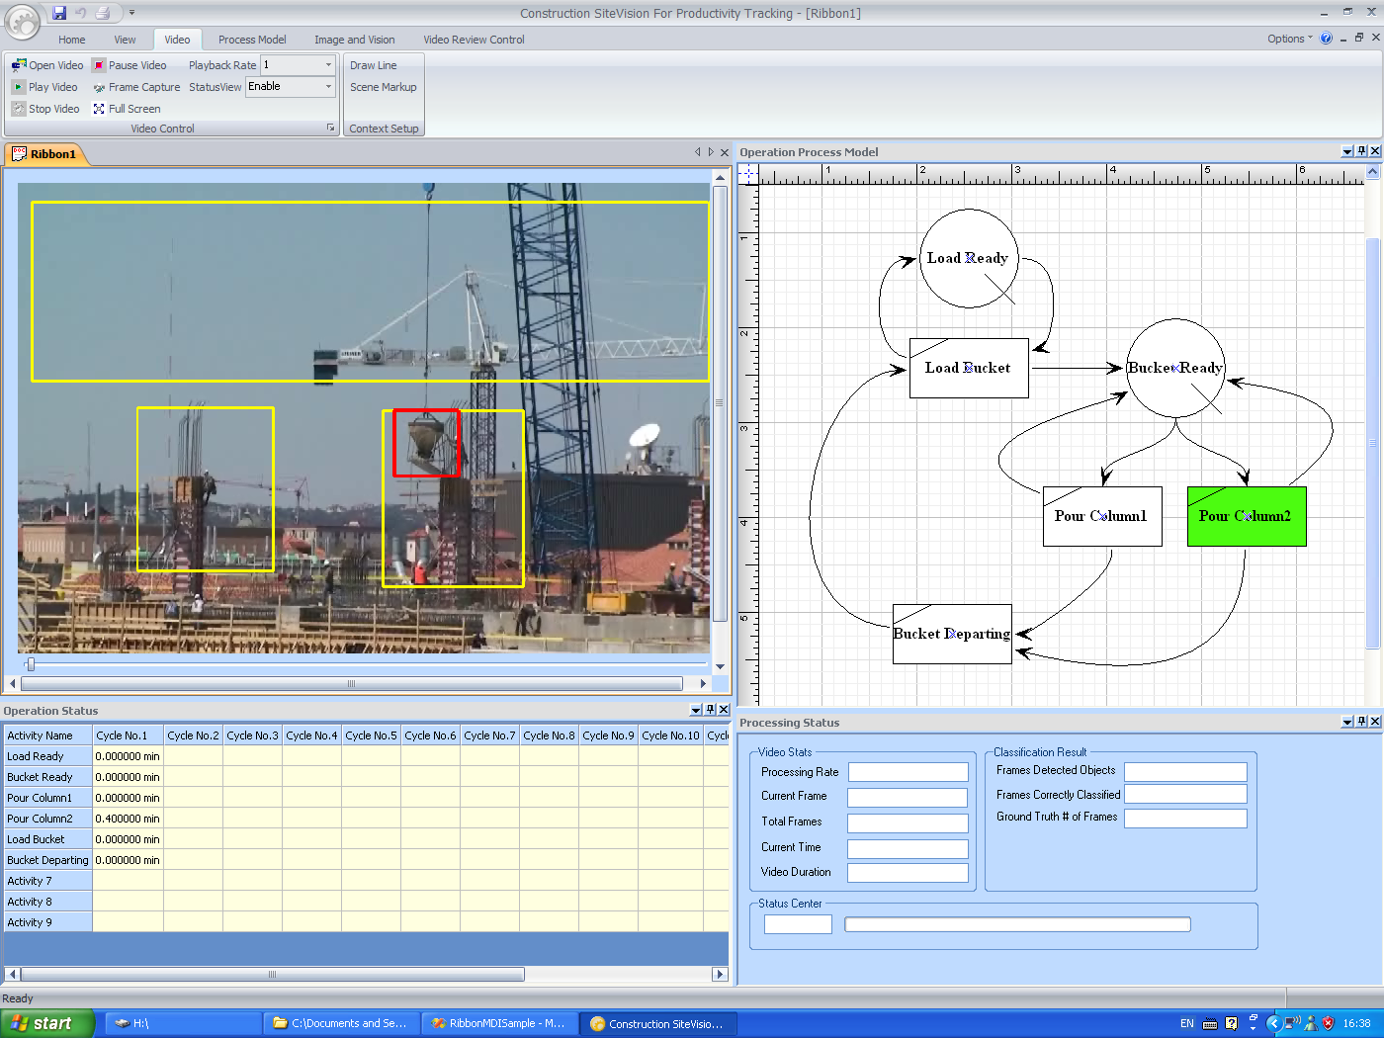
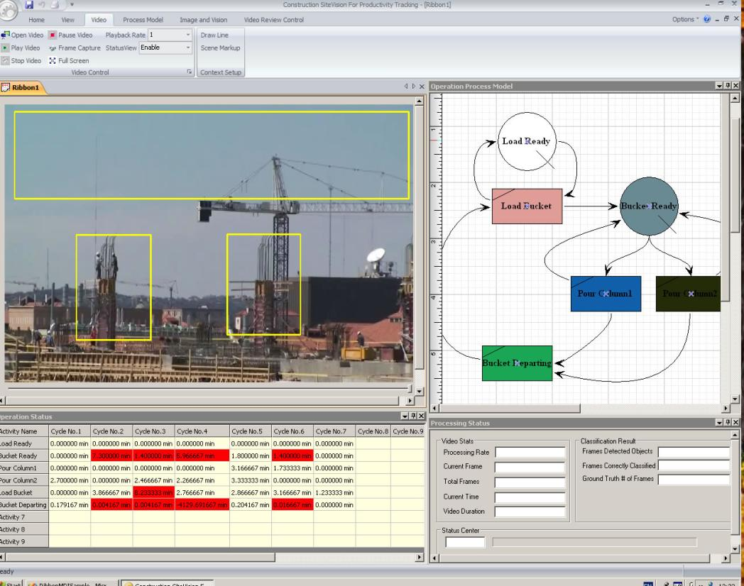
Demonstration – Column Pour

Slide 54
Analysis of Processing Results
Manual
Computer

Slide 55
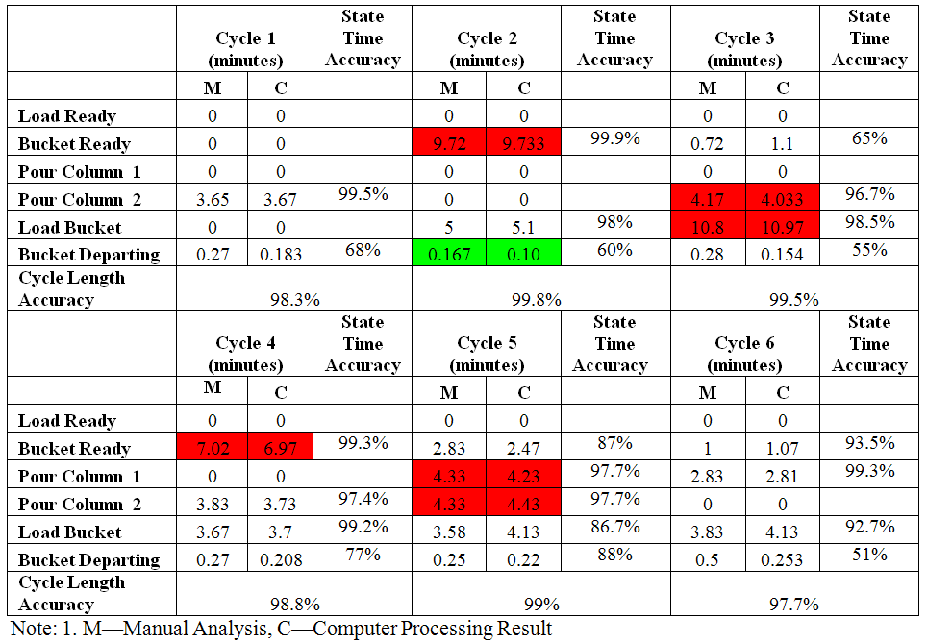
Analysis of Processing Results
Overall Time Utilization Accuracy: 90%
Time Constrain Violation
Sequence Violation

Slide 56
Semi-Automated Activity Analysis
Acknowledgement: My Former Ph.D. Student
Jung Yeol Kim, Ph.D.
Assistant Professor
Inha University, Korea

Slide 57
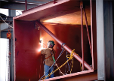
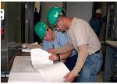
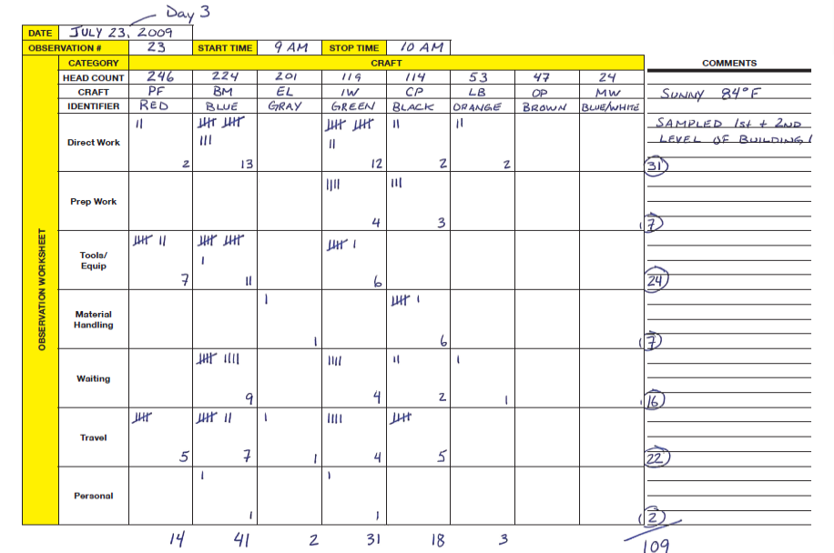
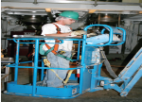

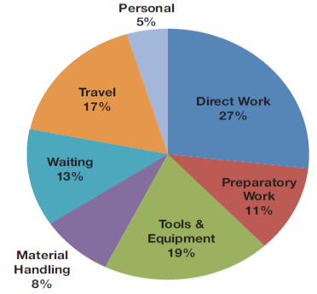
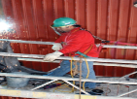
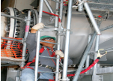

Activity Analysis
Definition
“A continuous process of measuring and increasing the amount of time that craft professionals spend on actual construction” (CII 2010b, iii).
Activity Analysis is an evolution of Work Sampling
Data Gathering: Manual Observation
Direct Work
Preparatory Work
Maximize
Tools and Equip.
Material Handling
Optimize
others
Waiting
Travel
Personal

Slide 58
Semi-Automated Activity Analysis
Plan Study
Sample
Semi-automated Data Collection
Analyze
Automated Data Analysis
Plan Improvements
Research Scope
Implement Improvements
Activity Analysis Process
Kim, J. Y. (2015) “Rapid and Contextual Activity Analysis: A Semi-automated Activity Category, Time, Location, and Video Data Collection and Analysis Methodology”. PhD Dissertation. University of Texas at Austin

Slide 59
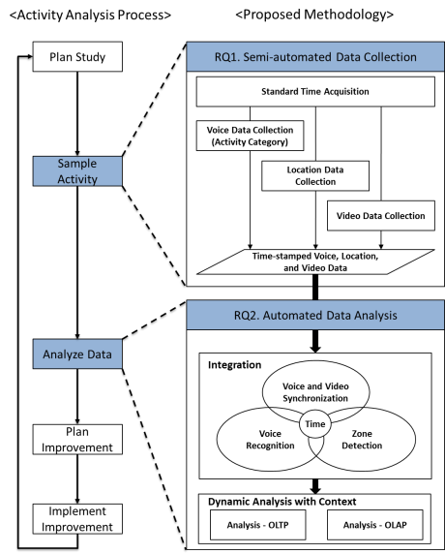
Semi-Automated Activity Analysis
Kim, J. Y. (2015) “Rapid and Contextual Activity Analysis: A Semi-automated Activity Category, Time, Location, and Video Data Collection and Analysis Methodology”. PhD Dissertation. University of Texas at Austin

Slide 60
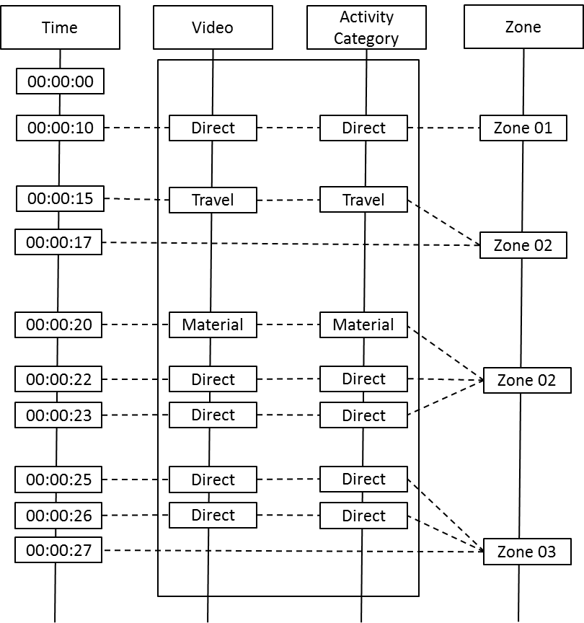
Integrated Data Collection
<Integrated Data Structure>
Kim, J. Y. (2015) “Rapid and Contextual Activity Analysis: A Semi-automated Activity Category, Time, Location, and Video Data Collection and Analysis Methodology”. PhD Dissertation. University of Texas at Austin

Slide 61
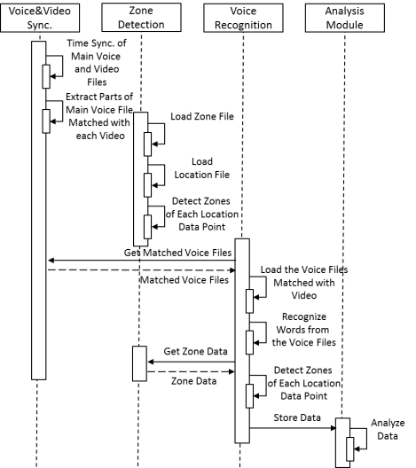
Integrated Data Analysis
<Sequence Diagram of Data Analysis>
Kim, J. Y. (2015) “Rapid and Contextual Activity Analysis: A Semi-automated Activity Category, Time, Location, and Video Data Collection and Analysis Methodology”. PhD Dissertation. University of Texas at Austin

Slide 62

Dynamic Analysis
Kim, J. Y. (2015) “Rapid and Contextual Activity Analysis: A Semi-automated Activity Category, Time, Location, and Video Data Collection and Analysis Methodology”. PhD Dissertation. University of Texas at Austin

Slide 63


Dynamic Analysis
Kim, J. Y. (2015) “Rapid and Contextual Activity Analysis: A Semi-automated Activity Category, Time, Location, and Video Data Collection and Analysis Methodology”. PhD Dissertation. University of Texas at Austin

Slide 64





Case Studies
Kim, J. Y. (2015) “Rapid and Contextual Activity Analysis: A Semi-automated Activity Category, Time, Location, and Video Data Collection and Analysis Methodology”. PhD Dissertation. University of Texas at Austin

Slide 65
Final Thoughts
Site sensing and data analysis provide opportunities for construction performance improvement in many areas.
Commercial applications have been developed, but many research challenges still need to be addressed.
We are continuing our journey to make research contributions that eventually will enable the development of fully integrated and automated project processes.

Slide 66
Thank you!
Carlos H. Caldas, Ph.D., PE
Department of Civil, Architectural and Environmental Engineering
The University of Texas at Austin
caldas@mail.utexas.edu

